Slide 1
Global Esports Revenue
Final Project Report
-By Mark Gonzalez

Slide 2
Table of contents
01
04
Introduction
Data Analysis and Insight
02
05
Questions of interest
Conclusion and Implications:
03
06
Data Source/ Description
The End

Slide 3
01
Introduction

Slide 4
Introduction
Here’s what you’ll find in this report:
Utilizing data from the Entertainment Software Rating Board (ESRB) and esports earnings.
Taking a careful look at the esports scene to understand its dynamics.
Finding connections between game genres, player engagement, and sponsorships.
Figuring out how popular game genres, player earnings, and sponsorships relate.
Spotting trends and patterns that shape the esports world.
Offering practical advice for making strategic decisions.
Showing the hidden opportunities in the esports market.
Providing useful guidance for those navigating the industry.

Slide 5
02
Questions of interest

Slide 6
Questions of Interest
Question 1
Question 2
Question 3
What are the predominant game genres in esports tournaments, and how do their earnings compare?
How has the popularity of esports evolved over the years, and has it impacted the diversity of game genres represented in tournaments?
Which game genres attract the most players and sponsors in esports, and are there any correlations between genre popularity and earnings?

Slide 7
03
Data Source/ Description

Slide 8
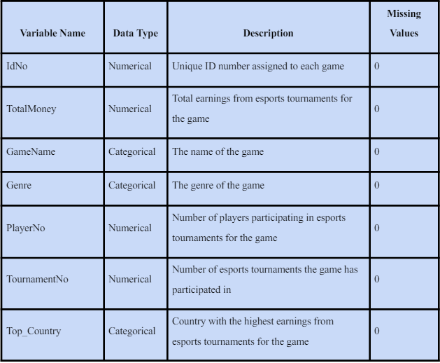
Data Source/ Description
The dataset has info on 1,895 games with 34 features for ESRB rating content, shown as binary values, along with game names and consoles. Esports, competitive video gaming, has gained popularity since the late 2000s, evolving from amateur to pro competitions and greatly influencing game development and industry investment by the 2010s.

Slide 9
04
Data Analysis and Insight

Slide 10

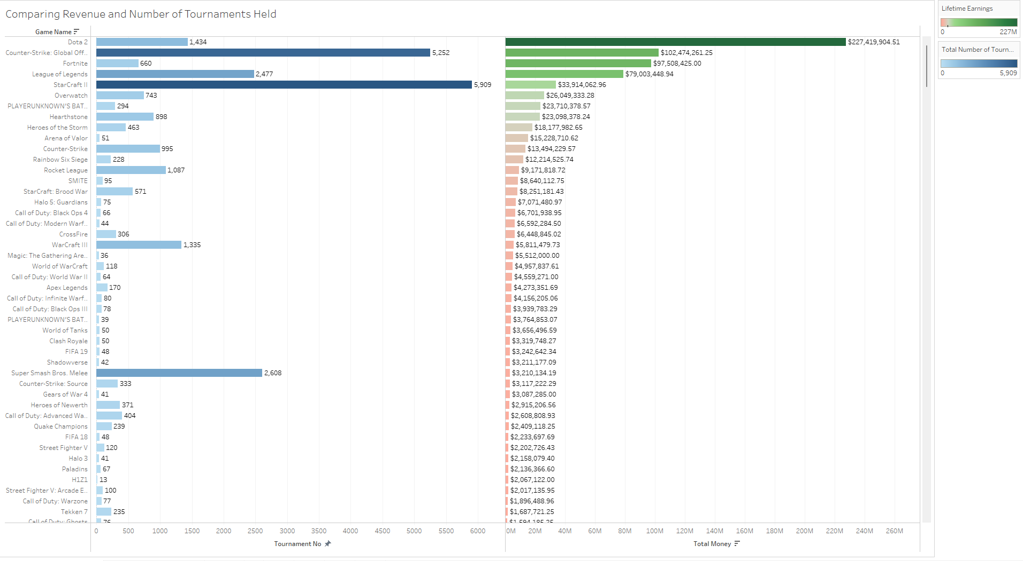
Figure 1.1: Comparing Revenue and Number of Tournaments Held
Venus
Venus is the second planet from the Sun
Mars
Despite being red, Mars is a cold place
Saturn
Saturn is a gas giant and hs several rings
40%
35%
25%

Slide 11
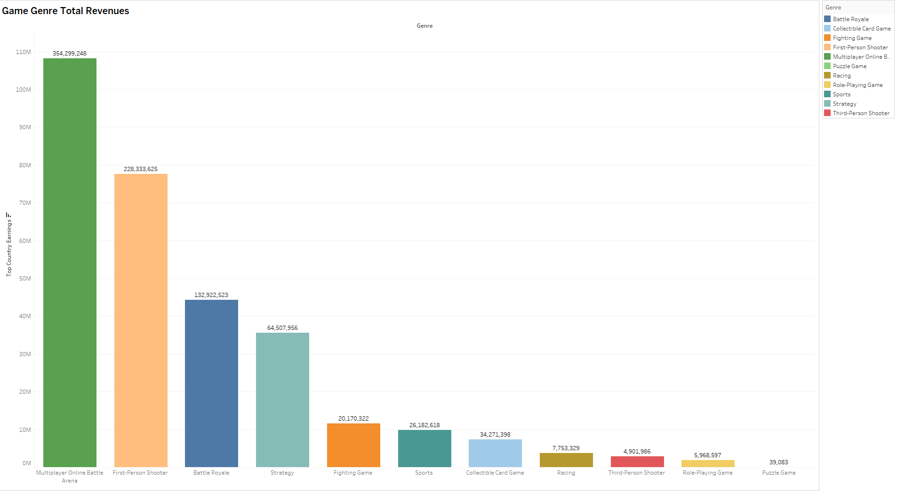
Figure 1.2: Game Genre Total Revenues
Venus
Venus is the second planet from the Sun
Mars
Despite being red, Mars is a cold place
Saturn
Saturn is a gas giant and hs several rings
40%
35%
25%

Slide 12
Question 1 Analysis
What are the predominant game genres in esports tournaments, and how do their earnings compare?
Figure 1.1 compares revenue and tournament counts for various video games, with Dota 2, CS: GO, and League of Legends emerging as leaders in both categories. They command significant player engagement and financial backing, reflecting their premier status in esports. In Figure 1.2, the graph illustrates the link between tournament frequency and financial success. While more tournaments generally mean higher earnings, certain games achieve exceptional revenue with fewer tournaments, likely due to higher stakes or broader viewer appeal.

Slide 13
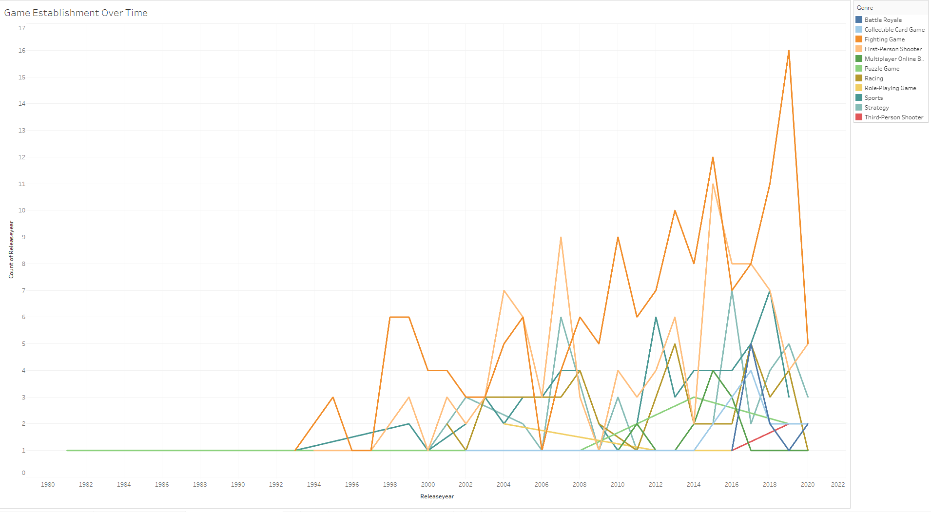
Figure 2.1: Game Establishment Over Time
Venus
Venus is the second planet from the Sun
Mars
Despite being red, Mars is a cold place
Saturn
Saturn is a gas giant and hs several rings
40%
35%
25%

Slide 14
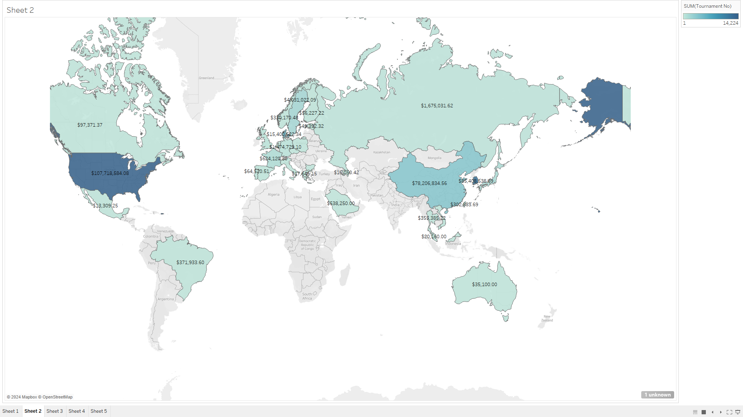
Figure 2.2: Highest Grossing Locations
Venus
Venus is the second planet from the Sun
Mars
Despite being red, Mars is a cold place
Saturn
Saturn is a gas giant and hs several rings
40%
35%
25%

Slide 15
Question 2 Analysis
How has the popularity of esports evolved over the years, and has it impacted the diversity of game genres represented in tournaments?
Figure 2.1 indicates that certain game genres, like Third-Person Shooters and Multiplayer Online Battle Royales, have become popular in esports despite fewer releases. The graph tracks shifts in preferences and the rise of new genres like Battle Royale games. Notably, First-Person Shooters and Multiplayer Online Battle Arenas (MOBAs) saw a surge around the early 2000s, aligning with esports' mainstream growth. While traditional genres remain favored, new ones are emerging, signaling a healthy expansion of the esports market.

Slide 16
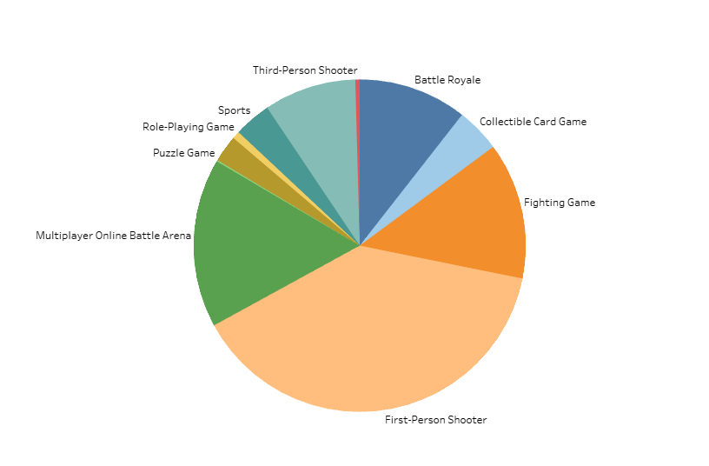
Figure 3.1: Most Popular Genres
Venus
Venus is the second planet from the Sun
Mars
Saturn
Saturn is a gas giant and hs several rings
40%
35%
25%

Slide 17
Question 3 Analysis
Which game genres attract the most players and sponsors in esports, and are there any correlations between genre popularity and earnings?
Figure 3.1 shows that the top two game genres attracting the most players and sponsors in esports are multiplayer online battle arenas (MOBAs) and first-person shooters (FPS). Additionally, we see in Figure 1.2, which ranks the highest total grossing genres, MOBAs and first-person shooters also lead the pack. This data suggests a correlation between genre popularity, particularly in MOBAs and FPS games, and earnings in the esports market.

Slide 18
05
Conclusion and Implications:

Slide 19
What This Means for the Gaming World
For Developers
For Investors and Sponsors
My findings point towards designing games that are similar to MOBAs and Battle Royales, which seem to be where the money's at. Targeting adult gamers might just be the key to success.
It seems like a smart move to put your money behind games with a massive player base and a solid tournament presence—that’s where the returns are

Slide 20
What This Means for the Gaming World
For Marketers
For Players
The massive viewership of esports tournaments presents a significant opportunity. Aligning marketing strategies with these popular games could be a game-changer.
If you're looking to go pro, it might be wise to focus on the big-name games where there’s more prize money.

Slide 21
Conclusion and Implications
In diving into the esports industry, I've discovered some key insights. Games like Dota 2, CS:GO, and League of Legends aren’t just popular; they’re the financial giants of the esports world. This suggests that when a game gets popular, it really rakes in the cash, and the more people play, the more money there is to be won. I also noticed a trend where games rated for 'Mature' audiences tend to earn more. This could mean that games targeting adults might be a sweet spot for making money in esports.

Slide 22
References:
Work Cited
Entertainment Software Rating Board (ESRB). (2022). Video Game Ratings by ESRB.
Contributed by John Doe. Retrieved from
https://www.kaggle.com/datasets/johndoe/video-game-ratings-by-esrb
"Awareness, Use and Trust Of ESRB Video Game Ratings Reach Historical High-Point Among
Parents." ESRB Ratings, 29 Mar. 2006, www.esrb.org.
Ahmed, Masood. Video Games Data. 2021, Kaggle,
www.kaggle.com/datasets/maso0dahmed/video-games-data.

Slide 23
06
The End!

